Slide 1
DODA Project
Group 18

Slide 2
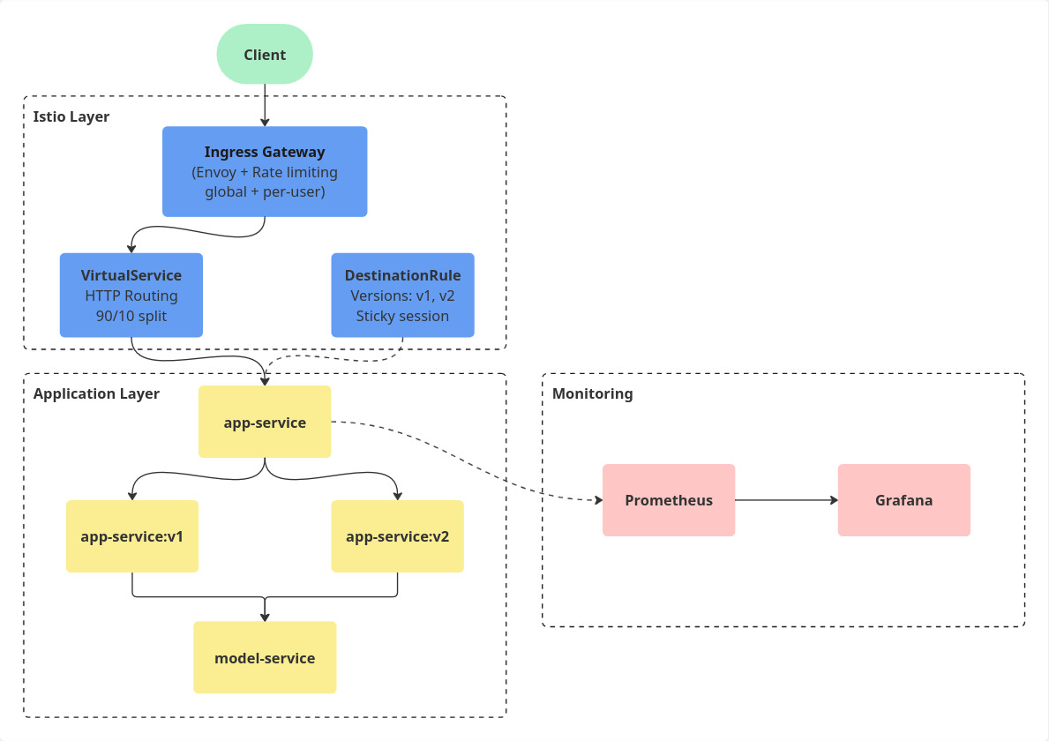
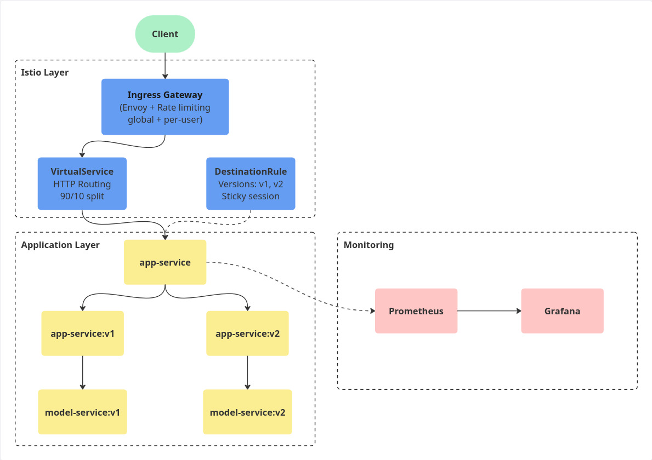
Overview of the project
Deployment of an sms classification service, in a scalable kubernetes environment

Slide 3
01
Assignment 1

Slide 4
Assignment 1
Automated image build and docker-compose deployment:
App
Model service
Automated training of the model
Lib-version as a version-aware library
Versioning strategy: pom.xml as single source of truth
Lib-version pre-releases on every push to a branch
App
Model
Lib-version

Slide 5
02
Assignment 2

Slide 6
Assignment 2
Provisioning a Kubernetes Cluster
Preparing to migrate to Kubernetes!
Kubernetes: Controller node
Schedules what to run and on which worker node
Kubernetes: 2 worker nodes
Managed by a Kubelet
Handles & restarts crashed pods
Run containers/pods assigned by controller
Containerd:
Runs containers inside of the pods scheduled/defined by K8s
Kubectl: K8s cluster command line tool
Controller
Worker
Worker

Slide 7
Assignment 2
Provisioning a Kubernetes Cluster
Flannel:
Basic inter-pod communication making pods reachable
Helm: the K8s package manager
Used via a helm chart (resource definitions for app)
E.g. Helm Diff - better Ansible idempotence detection (reprovisioning)
Nginx Ingress Controller
Enforces ingress rules & routes traffic
Grafana: Data visualisation

Slide 8
03
Assignment 3

Slide 9
Kubernetes Orchestration & Deployment
Central Helm Chart
Acts as the primary installation method for any cluster (e.g., Minikube)
Why Kubernetes?
Service discovery and load balancing
Self-healing
Static Docker Compose Setup
Key resources:
Deployments
Manage pod lifecycles
deployment-app
Services
Internal communication
service-app
deployment-model
service-model
Ingress
Make app reachable from outside the cluster
ConfigMaps & Secrets
Keep configuration data separated
configmap
ingress
secret

Slide 10

Application Monitoring & Metrics
/metrics endpoint in FrontendController for our metrics
1. num_predictions (Counter): Total request handled
2. correct_predictions_ratio (Gauge): fraction of user guesses that matched model’s output
3. predict_latency_seconds (Histogram): model response time
Used ServiceMonitor, which instructs Prometheus to automatically scrape /sms/endpoint every 5 seconds

Slide 11
Alerting
PrometheusRule
AlertManager
MailPit
Alert: HighPredictionRequestRate
More than 2 request per minute (testing values) -> fire alert
Responsible for deduplicating, grouping and routing the notification.
Captures the alert email notification.
Mocks an external mail provider.

Slide 12
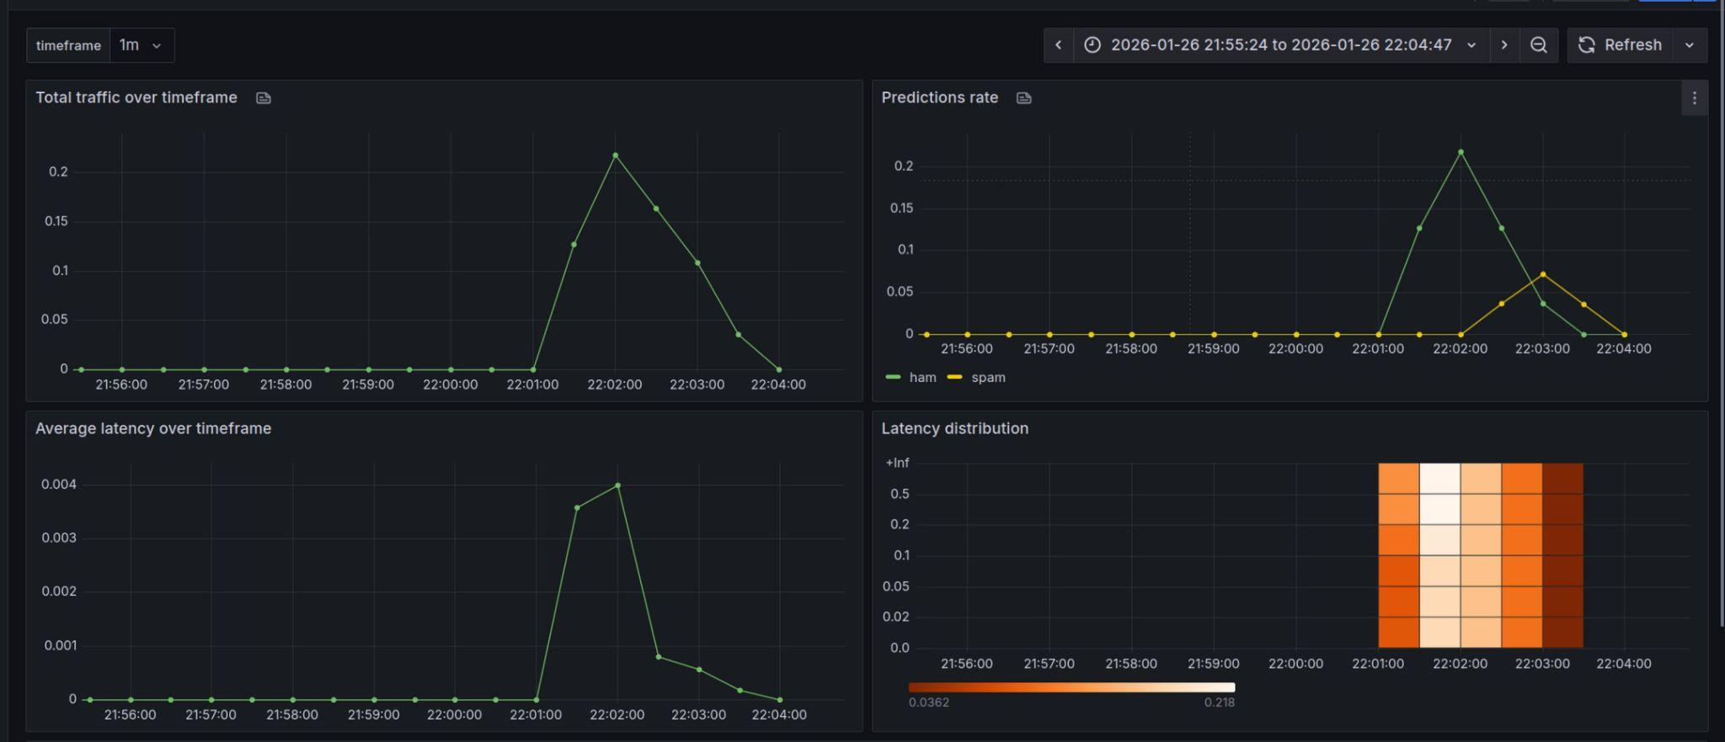
Visualization

Slide 13
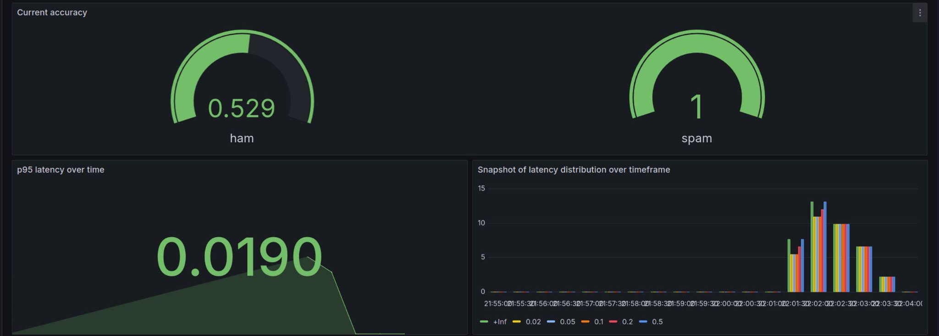
Visualization

Slide 14
04
Assignment 4

Slide 15
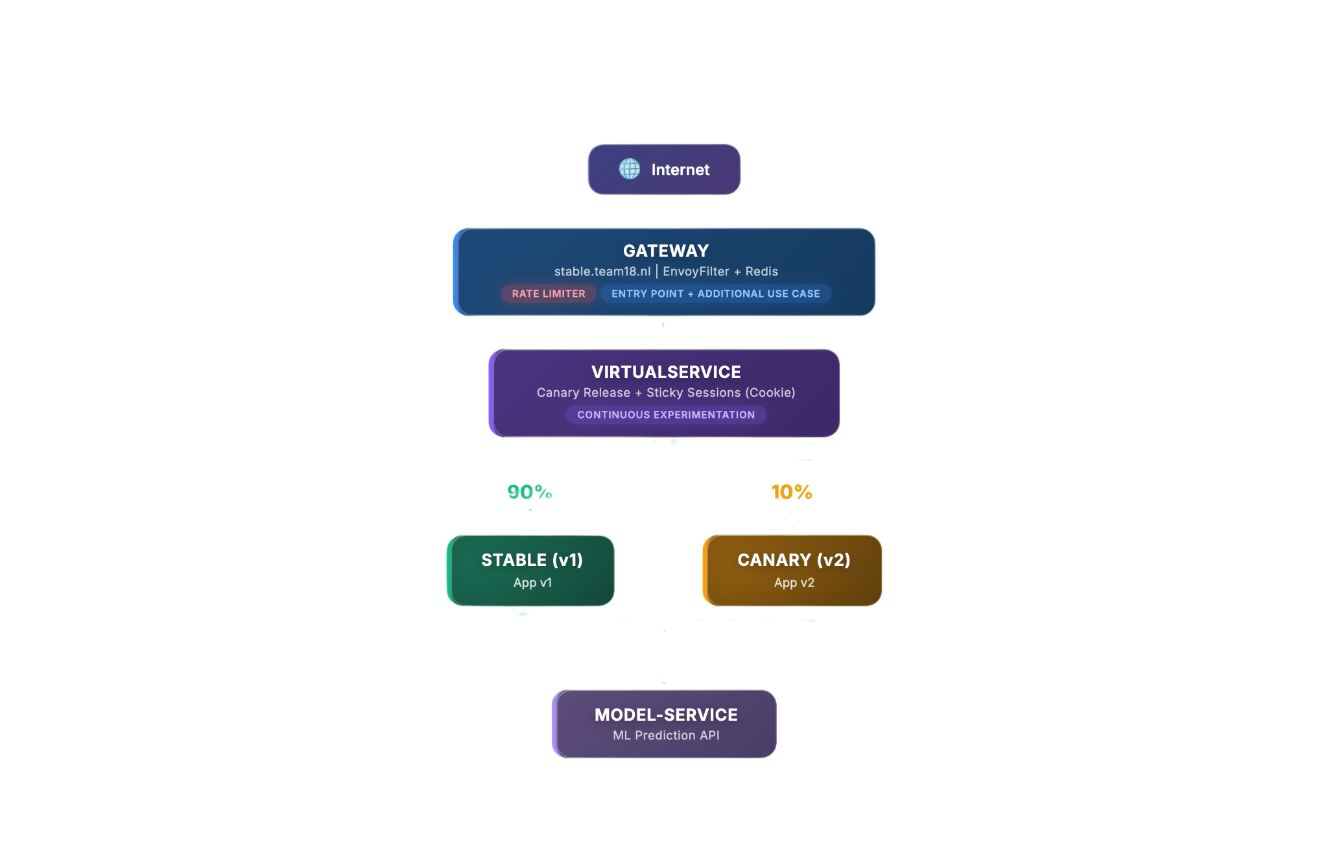
A4 Istio Service Mesh

Slide 16
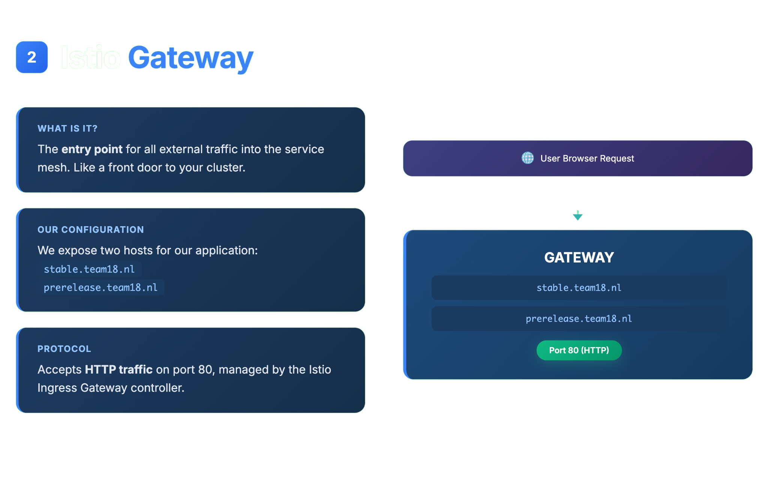

Slide 17
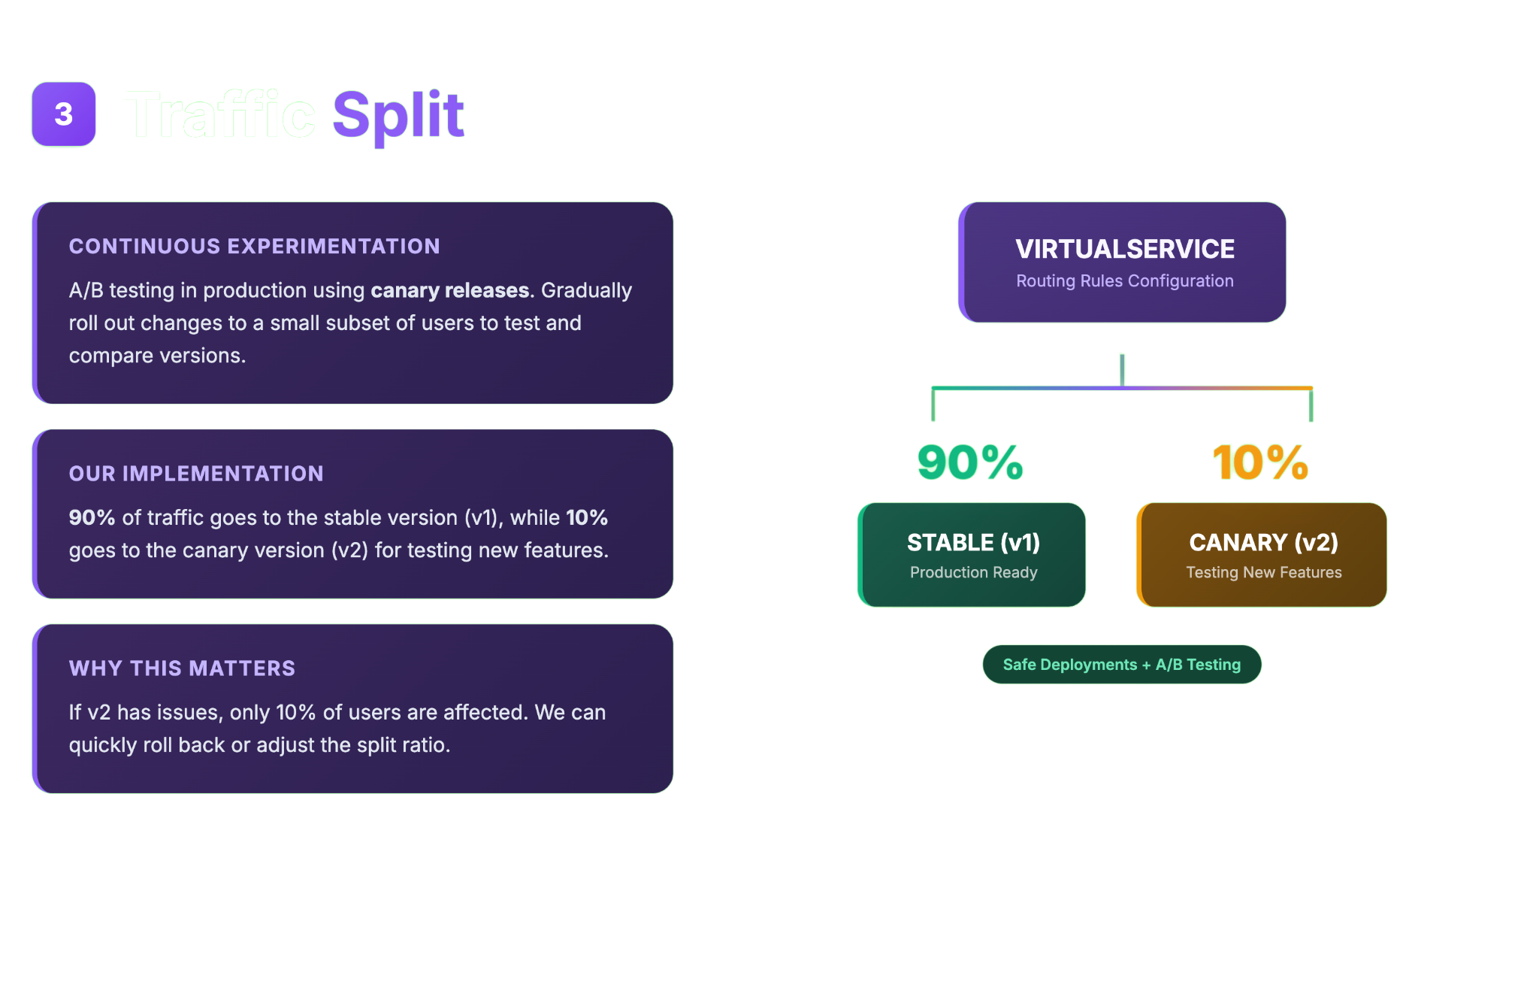

Slide 18
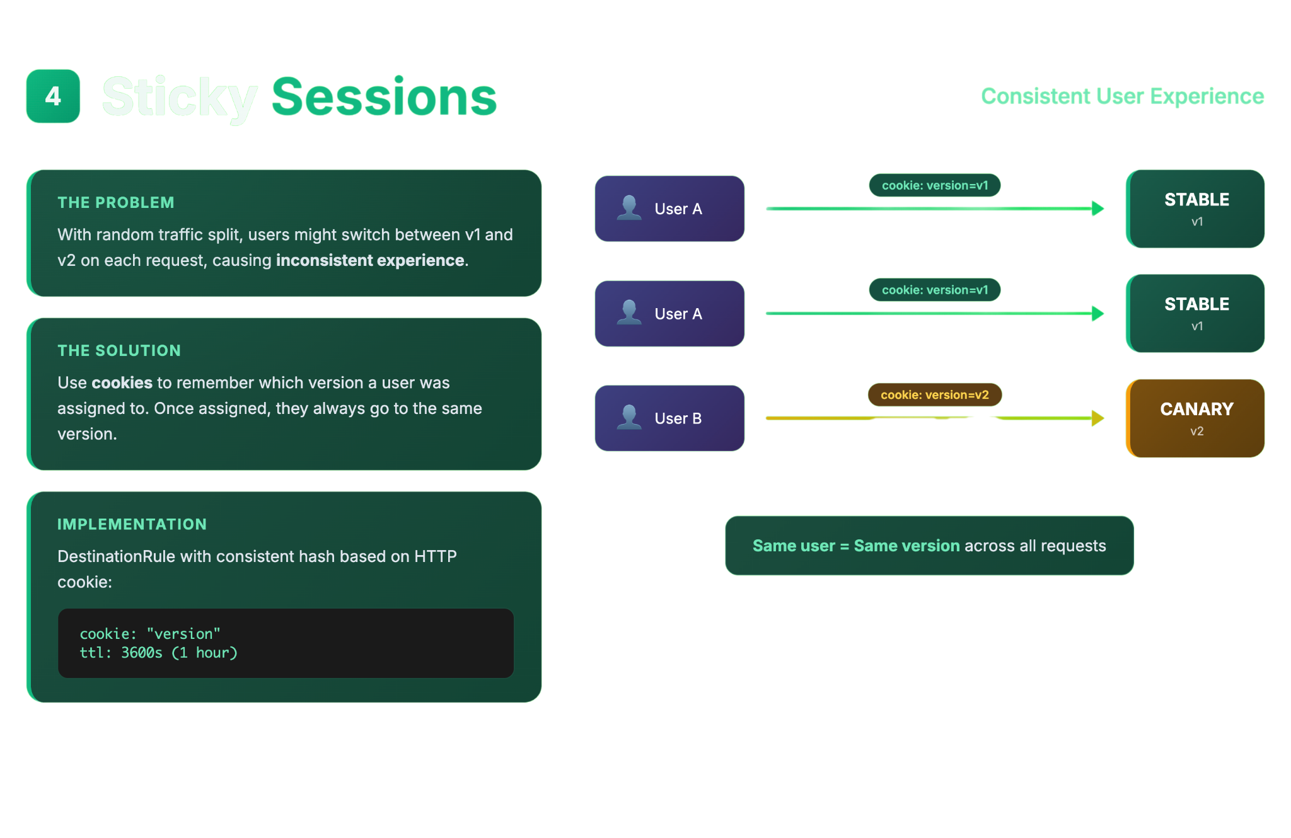

Slide 19
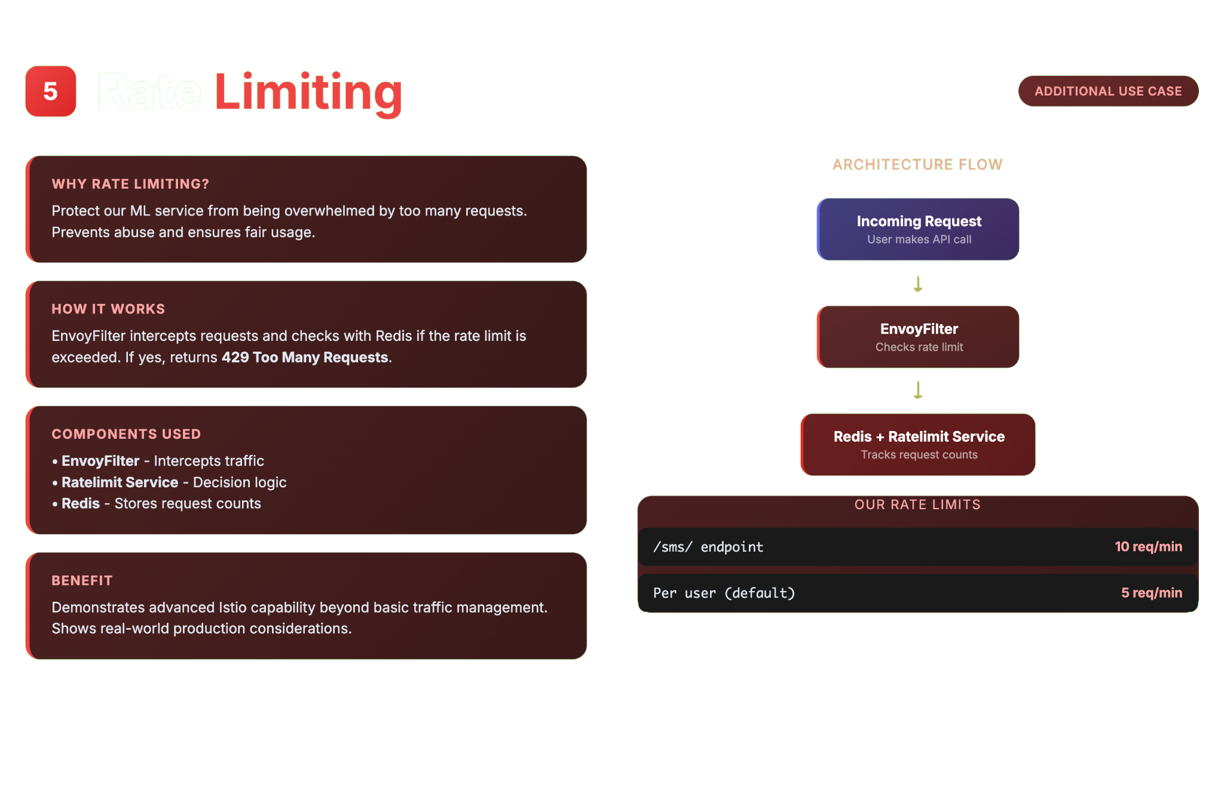

Slide 20
05
DEMO

Slide 21
Demo
Provisioned Kubernetes cluster
Kubernetes Dashboard
App: stable.team18.nl/sms/
v1: stable version
v2 : canary release
Prometheus
Grafana
Metrics dashboard
Cont. Experimentation Dashboard
Rate Limiting:
Global
Per-User
Alerts

